Slide 1

Human Resource Dashboard
Digital Egypt Pioneers Initiative – DEPI2025

Slide 2

Team Member
Ahmed Khaled
Rashad Maher
Sameh Ali
Esraa Hossam Eldin Ahmed
Ahmed Abass
Alaa Moazz

Slide 3

Agenda:
Data Cleaning
Data Modeling and Relationships
Interactive Visualizations
Dashboard Publishing
Notes:
Data Cleaning: Remove errors and duplicate entries to ensure data quality.
Data Modeling and Relationships: Organize data into a structured format and link related data.
Interactive Visualizations: Build charts and graphs that users can interact with to explore data.
Dashboard Publishing: Share the finalized dashboard for access and use by decision-makers.

Slide 4

Our Promise
The HR Dashboard is designed to provide a centralized and interactive platform for HR professionals and management to:
Provide real-time insights by visualizing key HR metrics and workforce trends.
Track and analyze workforce performance, including employee engagement, turnover, and productivity levels..
Enable data-driven decision-making to identify areas for improvement and optimize HR strategies.
Improve operational efficiency by Accessing critical HR information quickly and easily.

Slide 5
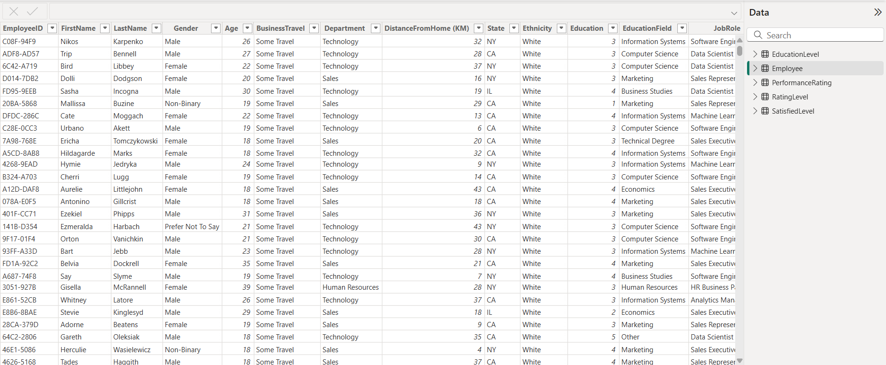
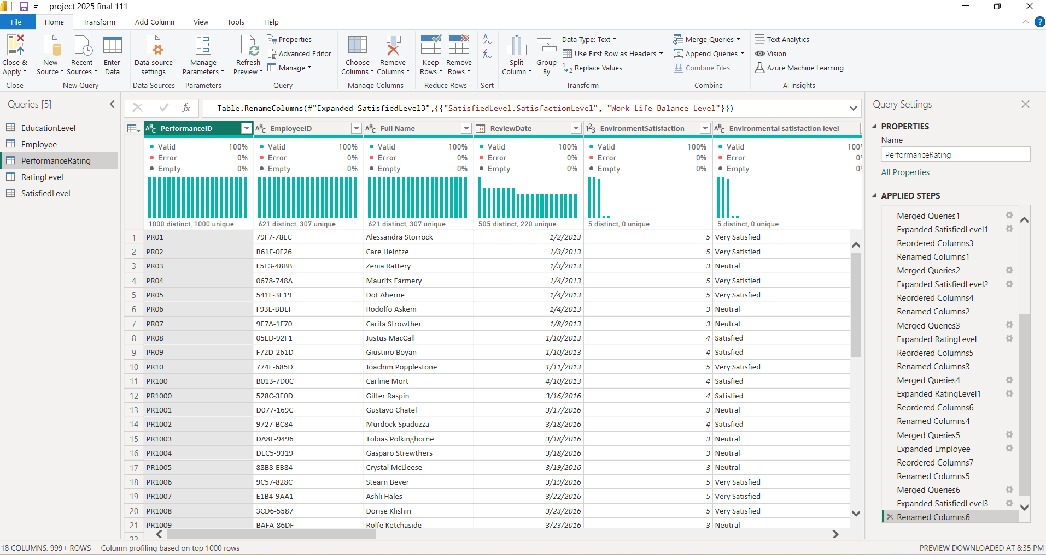
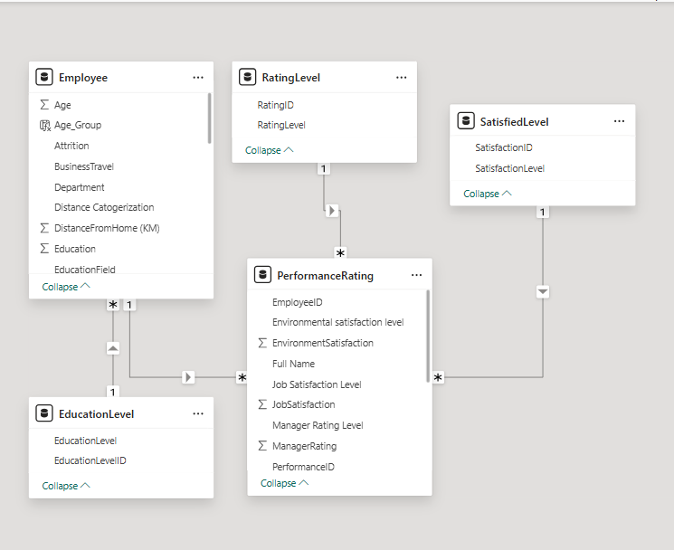
Data Cleaning & Modeling
Receiving 5 Csv files related to employees of company content their educational levels, their satisfactions &rating for work life overall.
Data was cleaned in Power Query by removing errors, renaming columns, and merging related tables efficiently.
A star schema was created by linking employee data with satisfaction levels, performance ratings, education, and rating levels for HR analysis.
Notes:
Data Model Summary (Star Schema)
PerformanceRating is the fact table, capturing job satisfaction, manager ratings, and environmental satisfaction.
Employee is a dimension table, linked via EmployeeID, providing demographic and job-related data.
EducationLevel connects to Employee, analyzing the impact of education on job roles.
SatisfactionLevel links to PerformanceRating, categorizing employees based on satisfaction scores.
RatingLevel is related to PerformanceRating, defining performance evaluation standards.
One-to-Many relationships ensure structured analysis, with Employee, Education, and Ratings as dimensions.
The model supports workforce insights, helping track performance, satisfaction, and retention trends.

Slide 6
Analysis Prospectives
Hiring Trend
Employee demographic distributions
Salary Analysis
Employees satisfactions & rating wok life
Attrition justifications

Slide 7
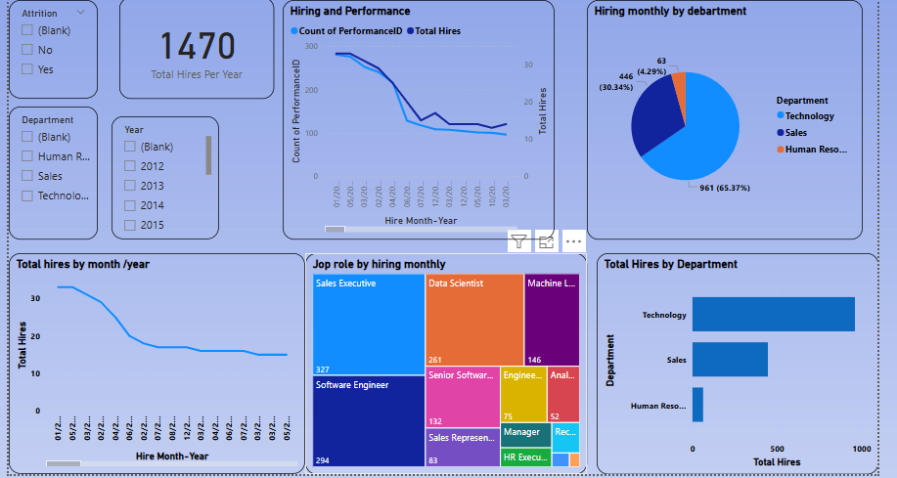
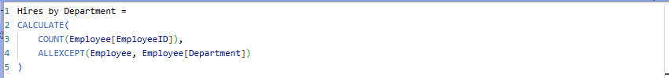

Hiring Trending
This report providing key insights into our hiring trends, departmental recruitment, and workforce expansion over time.
Top Hiring Department is Technology (961 hires) followed by Sales (446 hires, and HR (63 hires).
Most Recruited Roles is Software Engineers (327 hires) followed by Sales Executives (294) then Data Scientists (261).
Notes:
Total Hires: 1,470 employees
Hiring and Performance Over Time
Sharp decrease in both number of hires and performance evaluations over time.
Specific point highlighted: In March 2013, 14 hires and 107 performance evaluations were noted.
Hiring by Department
Technology: 961 hires (65.37% of total hires)
Sales: 464 hires (30.34% of total hires)
Human Resources: 63 hires (4.29% of total hires)
The majority of hiring is concentrated in the Technology department.
Top Roles Hired:
Software Engineer: 294 hires
Sales Executive: 327 hires
Data Scientist: 261 hires
Machine Learning Engineer: 146 hires
Others include Senior Software Engineer, Engineer, Analyst, Sales Representative, Manager, and HR Executive.

Slide 8
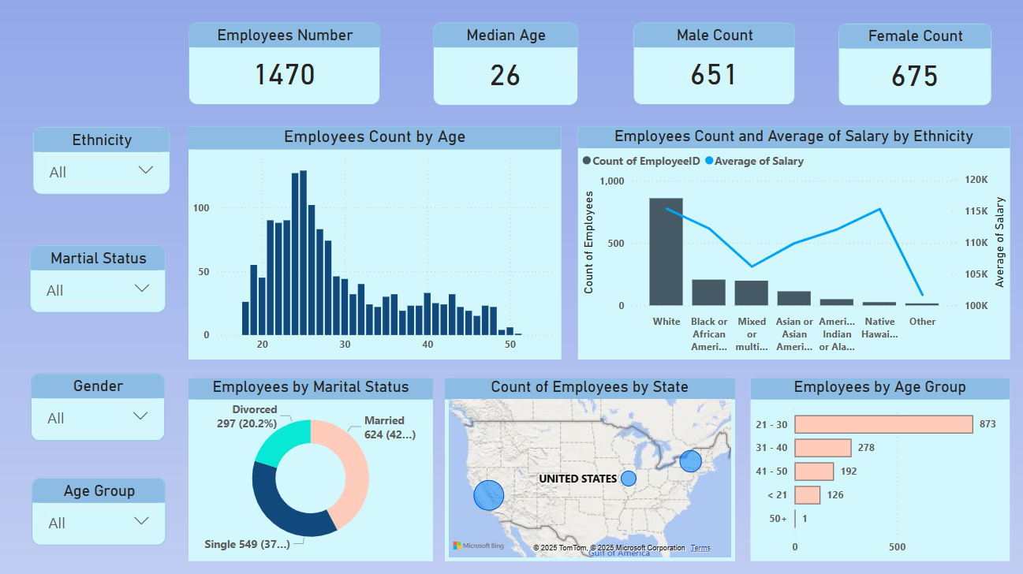
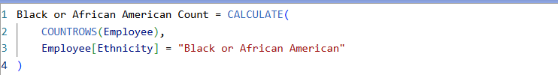
Employee Demographics
Demographics provide essential insights into the characteristics of a population within an organization, such as age, gender, ethnicity, and marital status.
The workforce of 1,470 employees has a median age of 26, with balanced gender distribution and predominantly White employees (860). A significant portion is married (624), while gender diversity has increased, and travel frequency varies across departments.
Average Employee Turnover is 17.25% and Average Employee Retention is 82.75%
Notes:
Workforce Overview: Total of 1,470 employees, with a gender split of 651 males and 675 females.
Age Profile: Median age is 26; 59% of employees are within the 20 to 30 age range, targeting early career professionals.
Ethnic Diversity: Composition is 34% White, 18% Black or African American, and 12% Asian.
Salary Insights: Average salary for White employees is approximately 5% higher than for Asian and 10% higher than for Black or African American employees, indicating a need for a review of compensation equity.
Geographic Distribution: Employees are predominantly located in major urban centers, supporting regional operations effectively.
Employees with Long Commutes: Long Distance is 526 (Sales & Technology dominate), Very Long Commute is 443 (Majority in Sales & Technology), Medium Distance is 314 and Short Distance is 177
Job Roles with Highest Turnover: Sales Representative is 49.62% then Recruiter: 46.15% and Data Scientist is 26.96%
Lowest Turnover & Highest Retention: Senior Software Engineers is 0% turnover and HR Executives is 11.32% turnover, 88.68% retention

Slide 9
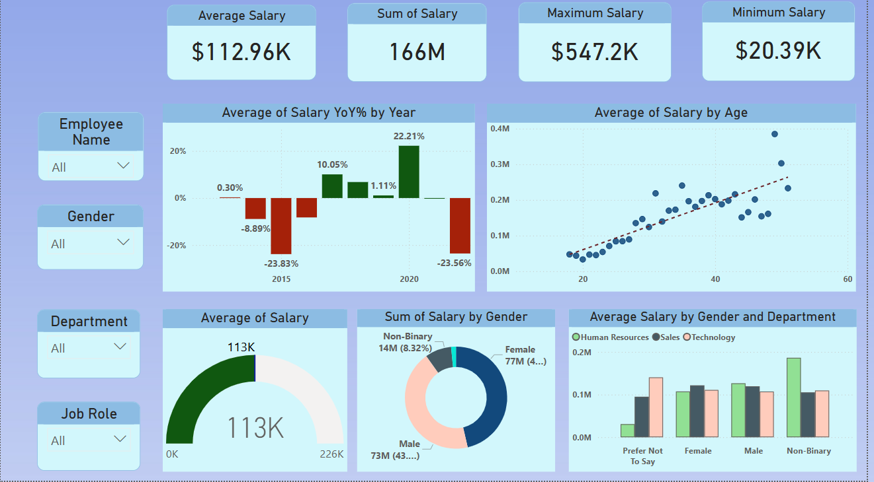
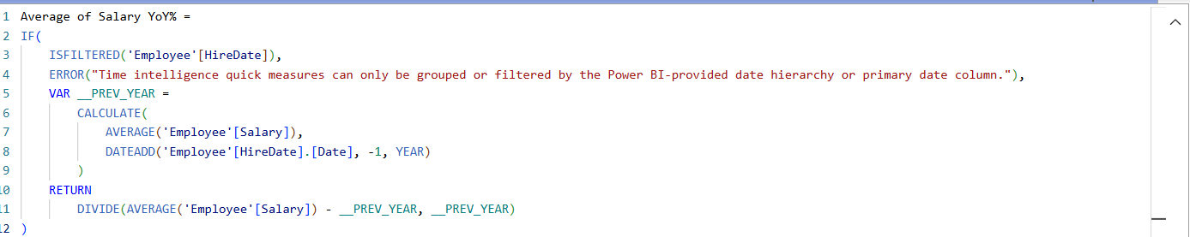
Salary Analysis
This report provides an in-depth analysis of salary trends, distribution by gender and department, and year-over-year salary growth fluctuations.
Total salaries: 166M, average salary: $112.96K, salary gap: $526.81K.
Salaries show fluctuations over time, with peak growth in 2020 and declines in 2015 and 2022. Technology leads in salary levels, while HR remains lower, and gender salary distribution is relatively balanced.
Notes:
Overall Salary Insights
Average Salary: $112.96K
Total Salary Sum: 166M
Maximum Salary: $547.2K
Minimum Salary: $20.39K
Salary Trends & Distribution
Year-over-Year Salary Growth: Fluctuations observed, with major declines in 2015 (-23.83%) and 2022 (-23.56%), while peak growth occurred in 2020 (+22.21%).
Salary by Age: Positive correlation—salaries generally increase with age.
Salary Breakdown by Gender
Males earn the largest salary share (73M, 43%).
Females account for 77M in total salary.
Non-binary employees represent 8.32% (14M) of total salary distribution.
Departmental Salary Comparison
Technology department leads in salary levels across genders.
Sales and HR salaries vary, with HR generally having lower earnings.
Non-binary employees earn higher average salaries in Technology.

Slide 10
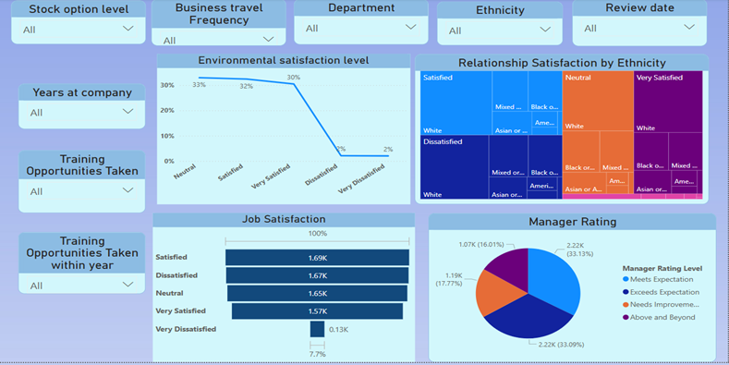
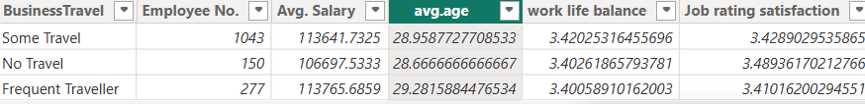
Employees Satisfactions & Rating
This report analyzes employee satisfaction, job perception, and manager ratings, influenced by environmental conditions, training opportunities, ethnicity, and years at the company.
Employee satisfaction is balanced (1.69K satisfied, 1.67K dissatisfied), manager ratings show 33.09% exceed expectations, and ethnic dissatisfaction varies.
Notes:
Environmental Satisfaction
30% of employees are very satisfied, while 33% remain neutral.
Dissatisfied employees (2%) indicate minimal workplace dissatisfaction.
Job Satisfaction
Satisfaction levels are balanced, with 1.69K satisfied employees and 1.67K dissatisfied employees.
Very dissatisfied employees are only 7.7%, showing low extreme dissatisfaction.
Relationship Satisfaction by Ethnicity
White employees show higher satisfaction, while dissatisfaction is observed across Black, Asian, and mixed ethnicities.
Manager Ratings
Exceeds Expectation (33.09%) and Meets Expectation (30.95%) dominate performance reviews.
Needs Improvement (17.77%) and Above and Beyond (16.01%) indicate room for growth and high performers.

Slide 11
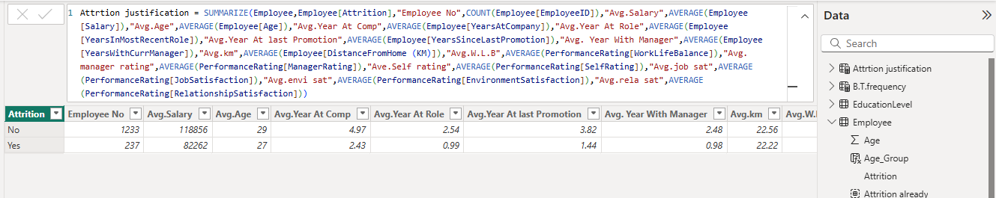
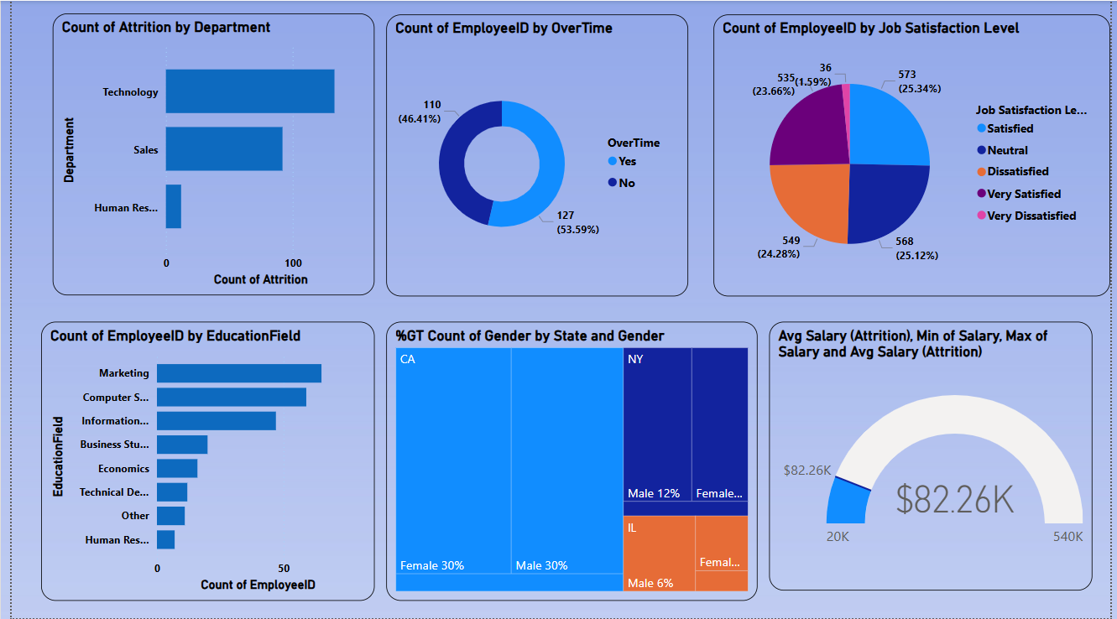
Attrition Justification & Analysis
Through several reports, we created several charts to determine the main reason behind employee's resignations from the company whether it is due to salaries, work environment, distance between home and workplace, level of education, ethnicity, or gender ...
237 employees left the company, resulting in an attrition rate of 16.12%.
Notes:
Total Attrition Overview:
237 employees left the company, resulting in an attrition rate of 16.12%.
Attrition Breakdown by Department:
Technology Department has the highest attrition, with 133 employees leaving, indicating challenges in retaining technical talent.
Sales Department follows with 92 employees leaving, which may suggest high job demands or competitive market conditions.
Human Resources has the lowest attrition, with only 12 employees leaving, suggesting more stability in administrative roles.
Attrition Breakdown by Gender:
114 males left, making up the largest portion of attrition.
104 females left, showing that both genders experience similar attrition rates.
19 non-binary employees left, which is a smaller number but still requires monitoring for diversity and inclusion impact.
Attrition Breakdown by Job Role:
Data Scientists have the highest attrition, with 62 employees leaving, possibly due to high market demand.
Sales Executives follow closely with 57 exits, indicating retention struggles in sales-related roles.
Software Engineers (47 exits) and Sales Representatives (33 exits) also show high turnover, likely influenced by competitive job opportunities.
Lower attrition in roles such as HR Executives (3 exits), Managers (2 exits), and Engineering Managers (2 exits) suggests stability in leadership roles.

Slide 12
Recommendations
Observation | Recommended Actions
Ethnic diversity is limited with 58.5% of employees being White, highlighting an imbalance in workforce representation. | Implement bias-free hiring to ensure 30% of new hires reflect underrepresented ethnic backgrounds.
The average commute distance is 22.5 km, with some employees traveling significantly farther. | Introduce flexible working options and remote work opportunities, aiming to reduce average commute times by 20%.
Minimize the salary gap between the highest and lowest paying departments which is 526,817. | Reduce salary gap from to less than $5,000 by implementing structured annual salary adjustments of 2-3% over the next three years.
Average work-life balance score is 3.4. | Increase the score to 4.0 through flexible working options and workload reviews.
The attrition rate in the Technology department is currently approximately 13.84% annually. | Aim to lower this rate to under 10% by 2025 through strategic enhancements in career development.
17.77% of employees received 'Needs Improvement' ratings to Managers, totaling 1,192 individuals | Reduce 'Needs Improvement' ratings to below 10% through personalized coaching and structured quarterly progress reviews.

Slide 13
Recommendations
-The employee turnover rate in the company is approximately 16%, while the market average stands at 10%.
- The possible reasons that may have contributed to employee resignations, are as follows:
1- It is evident that the average salaries of resigned employees are lower compared to those who remain in the company standing at 82,262 $ and 118,856 $ respectively. Therefore, the company should explore the need to adjust its salary structure.
2- It is evident that the average period of resigned employees in the company is shorter compared to those who remained standing at 2.43 and 4.97 years, respectively. Therefore, the company should investigate the reasons behind this difference.
3- It is evident that the average period of resigned employees with their last manager and in their last job role is shorter compared to those who remained in the company standing at0.98 and 2.48 years, and 0.99 and 2.54 years, respectively. Therefore, the company should investigate the reasons behind the higher internal turnover rate among resigned employees.
4- The number of resigned employees who did not receive any shares as dividend distributions stood at 154 out of 237, approximately 65%. The company should investigate the reasons behind this.

Slide 14





Thank You
April Hansson
+1 23 987 6554
april@treyresearch.com
Trey Research

